Slide 1

Golden State Housing Insights
Welcome to our predictive analysis of California's housing market. This presentation provides valuable insights for real estate stakeholders, using data-driven methods to guide investment decisions in California Metro Areas.

Slide 2

Executive Summary
1
Housing Prices and ROI Analysis
Examining the current trends and potential returns on investment in the California housing market.
2
Housing Feature Analysis
Identifying key features that influence housing prices and their impact on market value.
3
Housing Interest Rate Analysis
Analyzing the effects of interest rates on housing prices and market dynamics.
4
Team Goal
What are the key interrelationships between housing price as dictated by home features and interest rates as well as housing price for California metro area returns over time?

Slide 3




Team Approach
Strategic Task Allocation
Organized Workflow
Detailed Analysis
Utilized separate notebooks for efficient organization and collaboration.
Examined data-analysis techniques and modeling thoroughly, fostering diverse perspectives.
Assigned tasks based on individual strengths to optimize team contributions.

Slide 4

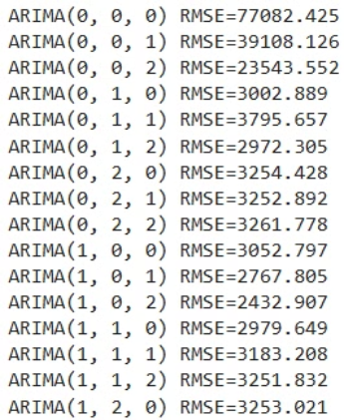
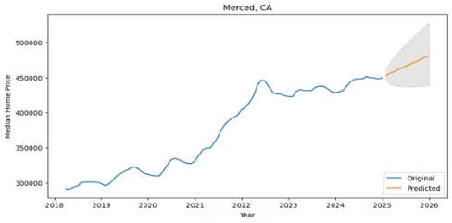
Housing Price Prediction with Zillow Data Analysis
Data Pre-Processing
Model Training
Utilized NumPy and Pandas for data manipulation
We used ARIMA and SARIMA models for housing price prediction. Comparing both models improved prediction accuracy and robustness.
Used Matplotlib for visualization
Applied data melting for reshaping datasets
Results
Excluded metro areas with high p-values
ARIMA model: 90% ROI accuracy; 10% off observed values
Incorporated time series analysis for temporal trends
SARIMA model: 85% ROI accuracy; 15% off observed values

Slide 5
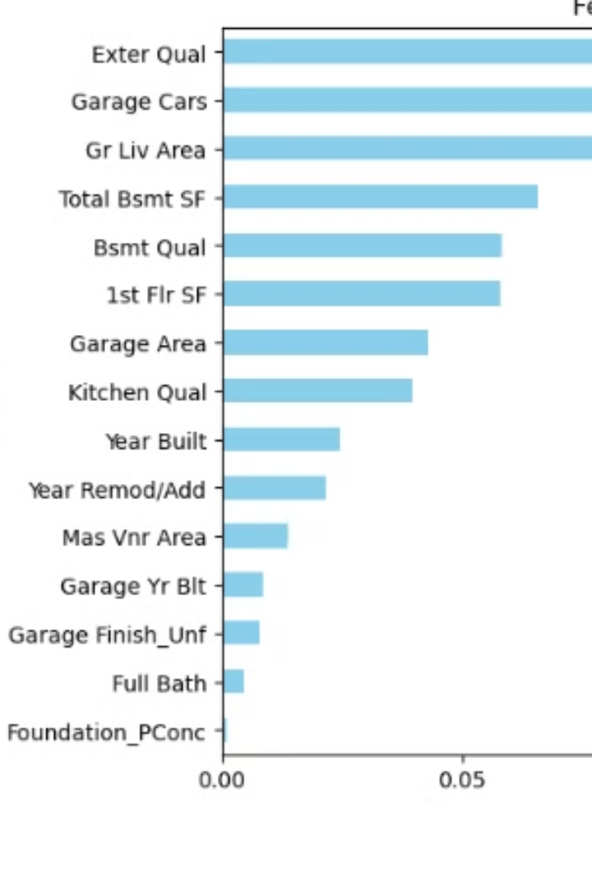
Housing Feature Analysis
1
Data Pre-Processing
Removed outliers from key features, used heatmaps to identify impactful variables, and split data: 80% training, 20% testing. Standardized values with StandardScaler.
2
Model Training
Trained a Linear Regression model and made predictions, showing general alignment with actual prices but indicating areas for improvement.
3
Feature Importance
Used Random Forest and recursive feature elimination, evaluating performance with RMSE, R², and MAE metrics to understand home price factors.
4
Results
The top five factors influencing house prices are Median Income, House Age, Average Number of Rooms, exterior quality, and Garage size.

Slide 6
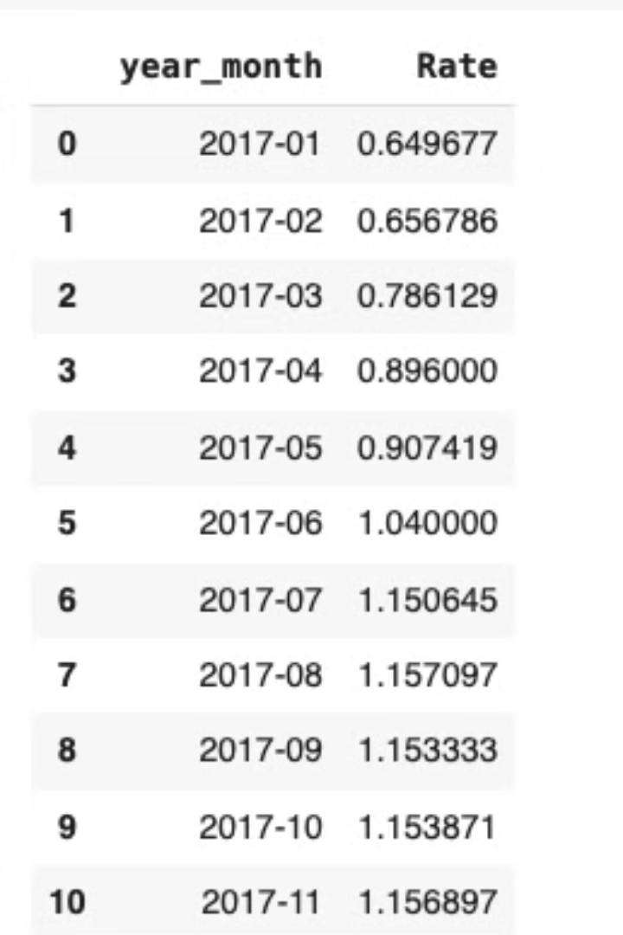
Interest Rate Prediction Analysis
Data Pre-Processing
Model Training
Utilized Linear Regression and KNN models for feature analysis. The model was trained using the model.fit(X_train, y_train) method, allowing it to learn from the training data.
Utilized Pandas for data manipulation, removed nulls, and grouped data. Used Matplotlib for visualization.
Results
The model predicts that interest rates will rise through February 2025, providing valuable insights for investment decisions.

Slide 7



Future Development
Improved Accuracy
1
Improve prediction accuracy with continual optimization
Larger Dataset
2
Incorporate more comprehensive data
Investment Recommendations
3
Refine and expand our insights
By leveraging a larger dataset, we aim to enhance the reliability and precision of our investment recommendations. This will allow us to provide more accurate and valuable insights for real estate stakeholders in California's dynamic housing market.

Slide 8




Conclusion
Interconnected Factors
Valuable Insights
1
Uncovered investment opportunities
2
ROI, features, and interest rates
Informed Decisions
4
Continuous Optimization
3
Guide economic policies
Need for model refinement
Our housing market analysis highlights the interconnected effects of ROI, housing features, and interest rates on California's real estate prices, emphasizing the need for continuous model optimization to guide policies and investments.

Slide 9






Project Contributors
Chris Gilbert
Will Atwater
Dexter Johnson
Joel Freeman
Rod Burroughs
Jacinto Cepeda Quiroz

Slide 10
Demonstrations
StreamLit Demonstration
1
Interactive showcase of predictive models
Visualizations
2
Dynamic display of project findings
Results Presentation
3
Comprehensive overview of project outcomes

